Slide 1
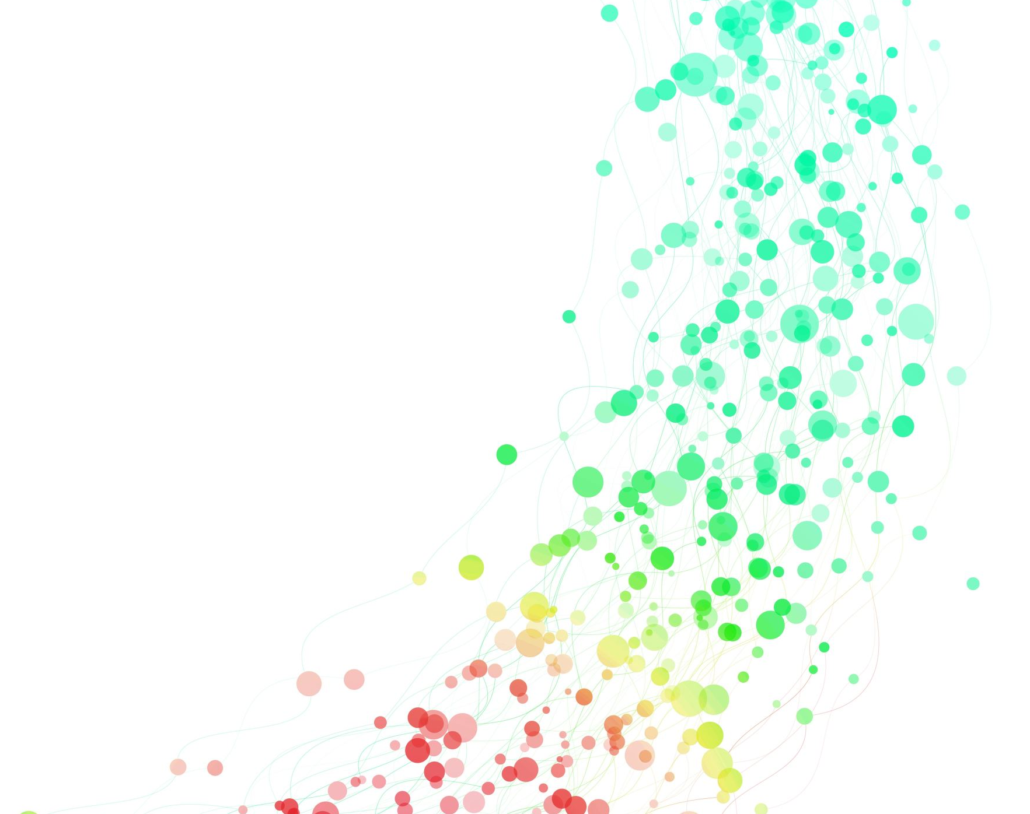
NETW211 Final Project

Slide 2
Introduction
This project covers a lot of the basics of VM’s, everything from deploying a VM, creating subnets, verifying the connections between to VM’s , accessing files , blob snapshots and testing alerts and few more of the many things that can be done with a VM.

Slide 3
Career Skills
Deploying VMs
Testing connections between different VM’s
Configuring a NSG
Testing alerts

Slide 4
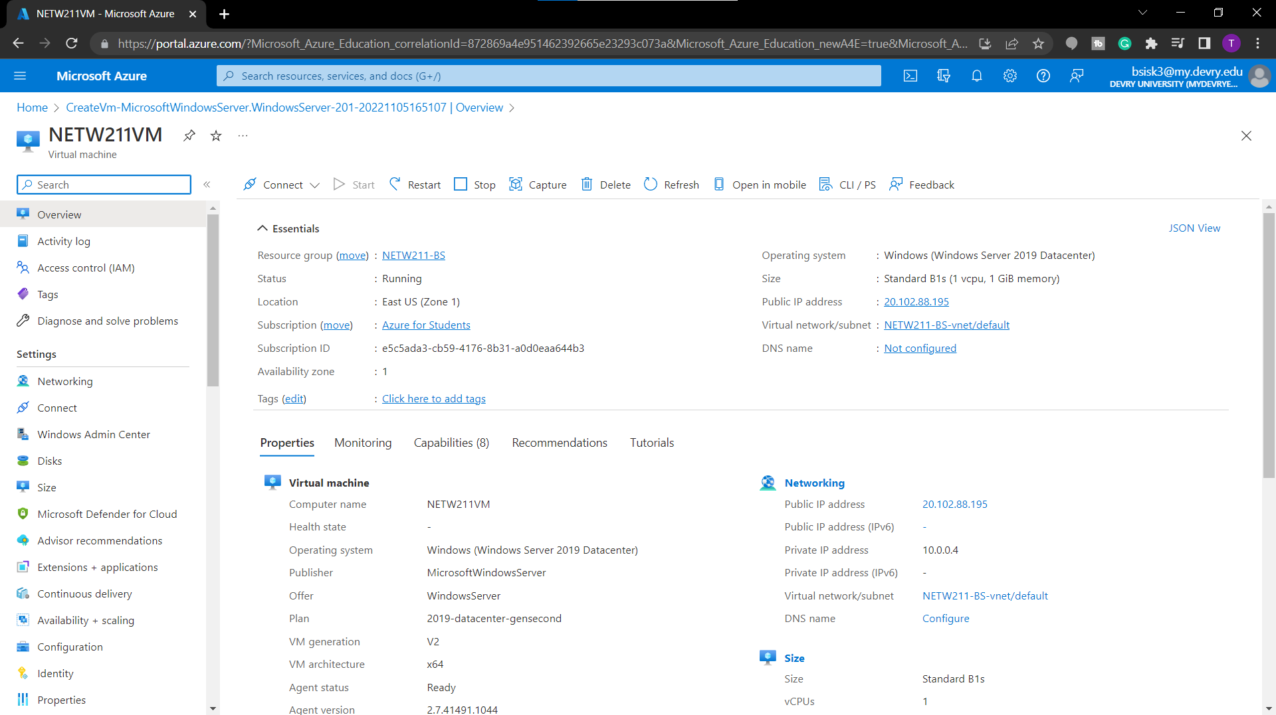
Deploying a VM in Azure

Slide 5
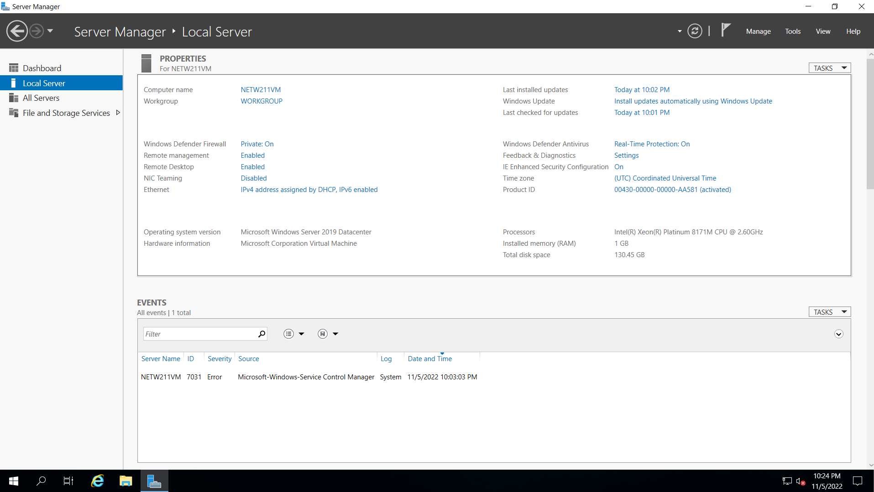
Connecting to the VM

Slide 6
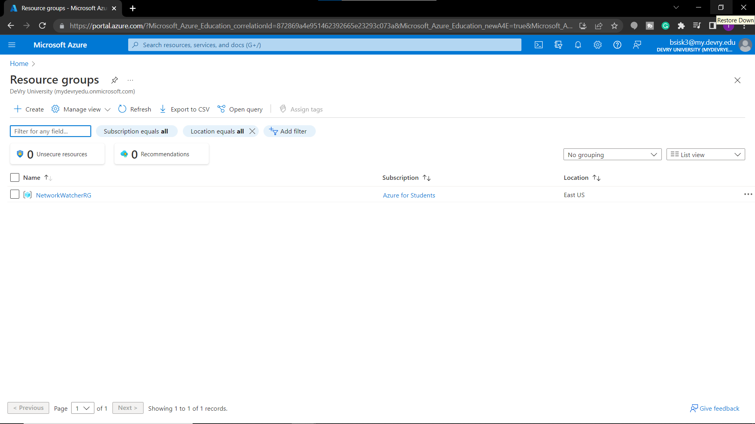
Deleting the VM

Slide 7
Deploying a VM in Azure

Slide 8
Connecting to the VM

Slide 9
Creating a VNet with Two Subnets
1. With a /24 network prefix, how many usable IPv4 host addresses are there? [hint: you learned this in NETW191]
Answer here: 254
2. Given the answer above, why is the number of available IP addresses for Subnet0 (10.0.0.0/24) or Subnet1 (10.0.1.0/24) shown as 251? [hint: where did the missing addresses go?]
Answer here: In IPv4, there are two IPs that cannot be assigned to any devices. These are the Network ID and the Broadcast IP address. Therefore, you need to subtract two addresses from the total IP formula.
References (here are two examples to get your research started):
1. IP Subnet Calculator, https://www.calculator.net/ip-subnet-calculator.html
2. Azure Virtual Network frequently asked questions, https://docs.microsoft.com/en-us/azure/virtual-network/virtual-networks-faq
3. https://hub.packtpub.com/understanding-address-spaces-and-subnetting-in-ipv4-tutorial/
4.

Slide 10
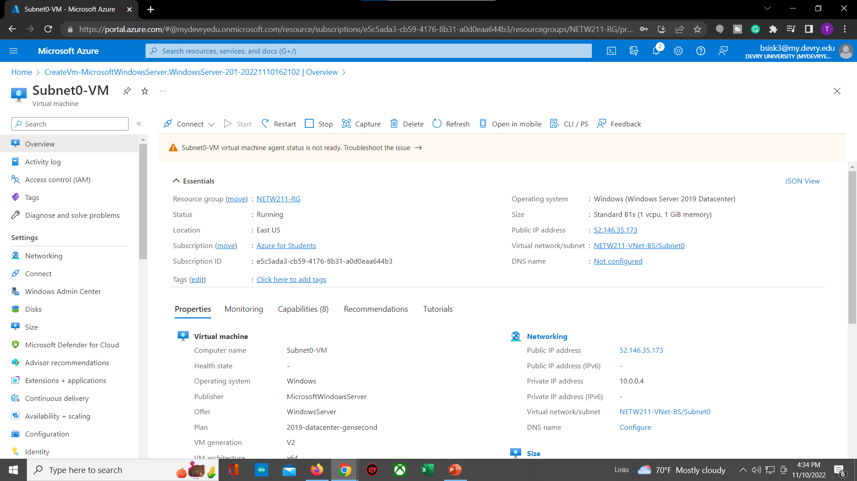
Deploying VMs into Subnets

Slide 11
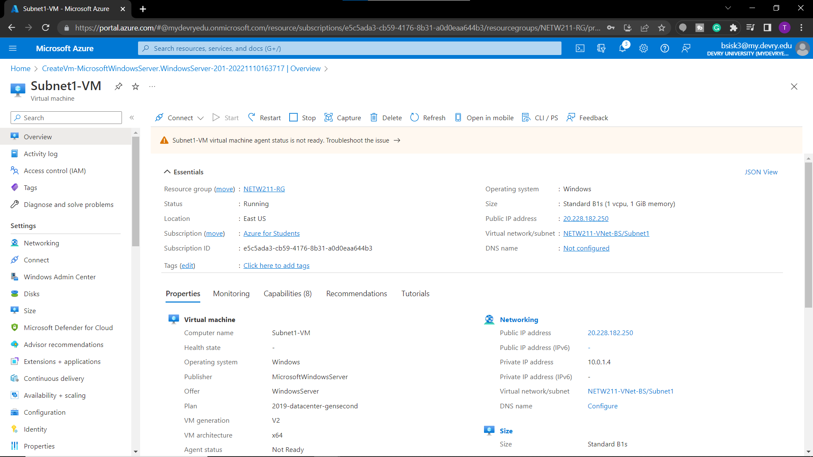
Deploying VMs into Subnets cont’d

Slide 12
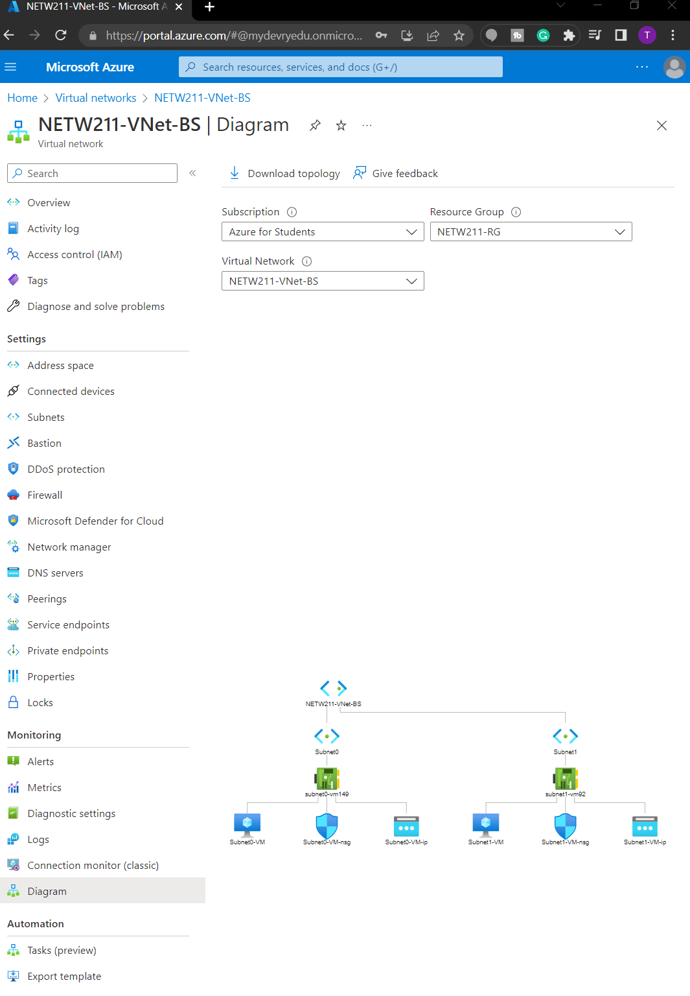
Deploying VMs into Subnets cont’d

Slide 13
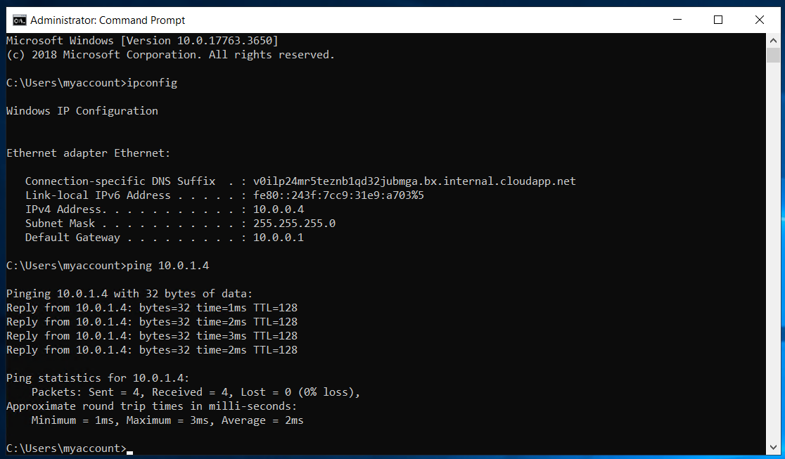
Verifying Connectivity between VMs

Slide 14
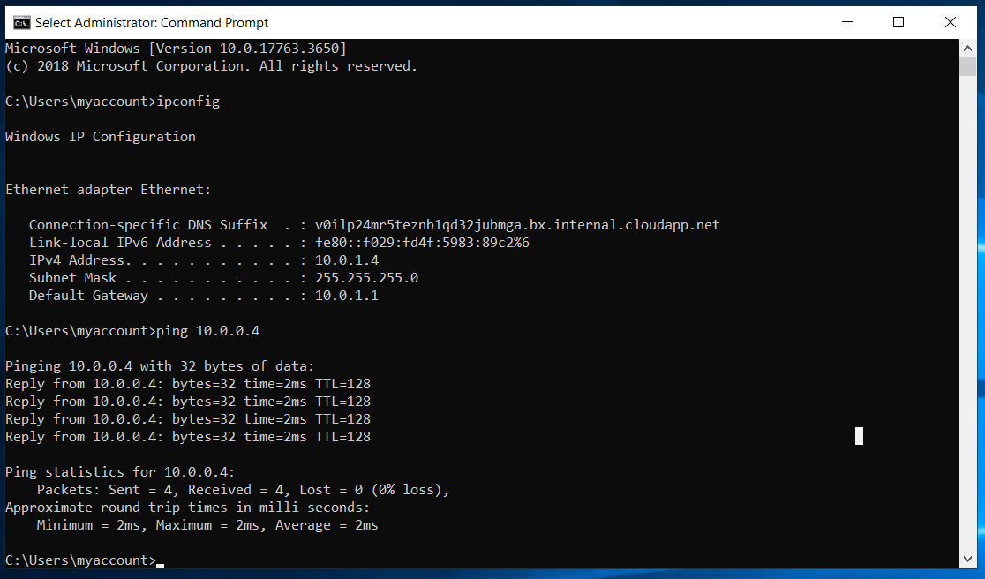
Verifying Connectivity between VMs
cont’d

Slide 15
Verifying Connectivity between VMs

Slide 16
Verifying Connectivity between VMs
cont’d

Slide 17
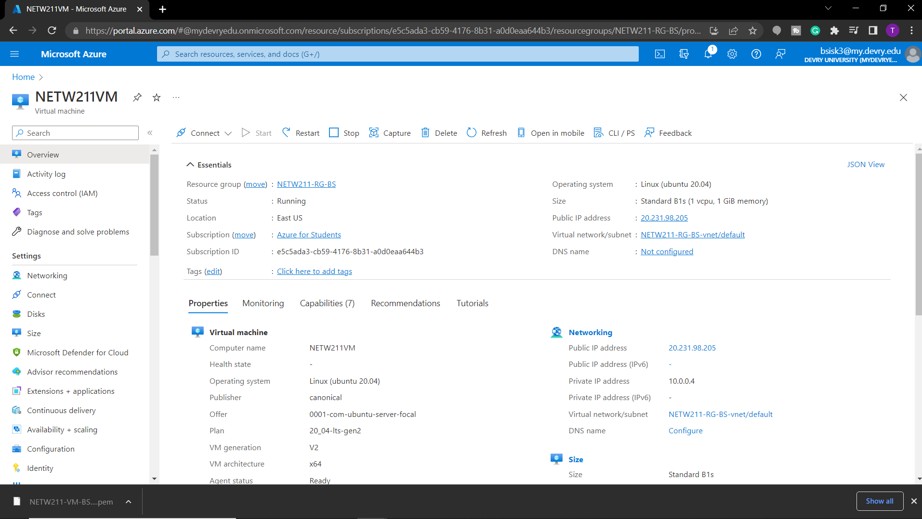
Launching a VM

Slide 18
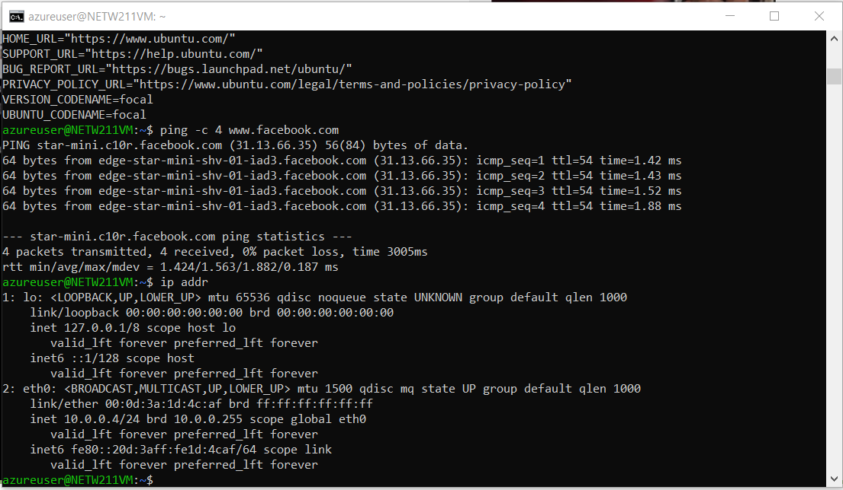
Connecting to the VM
via SSH

Slide 19
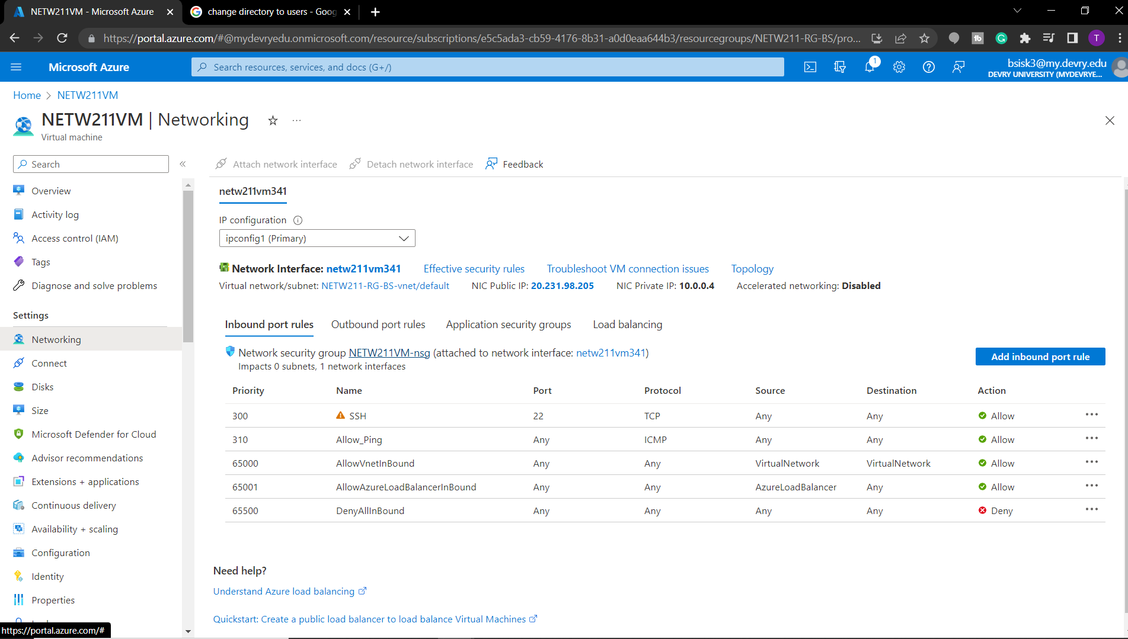
Configuring an NSG

Slide 20
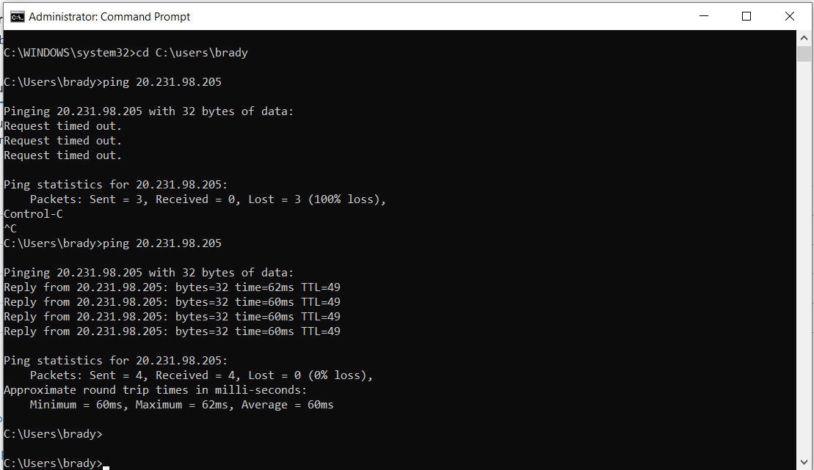
Configuring an NSG
cont’d

Slide 21
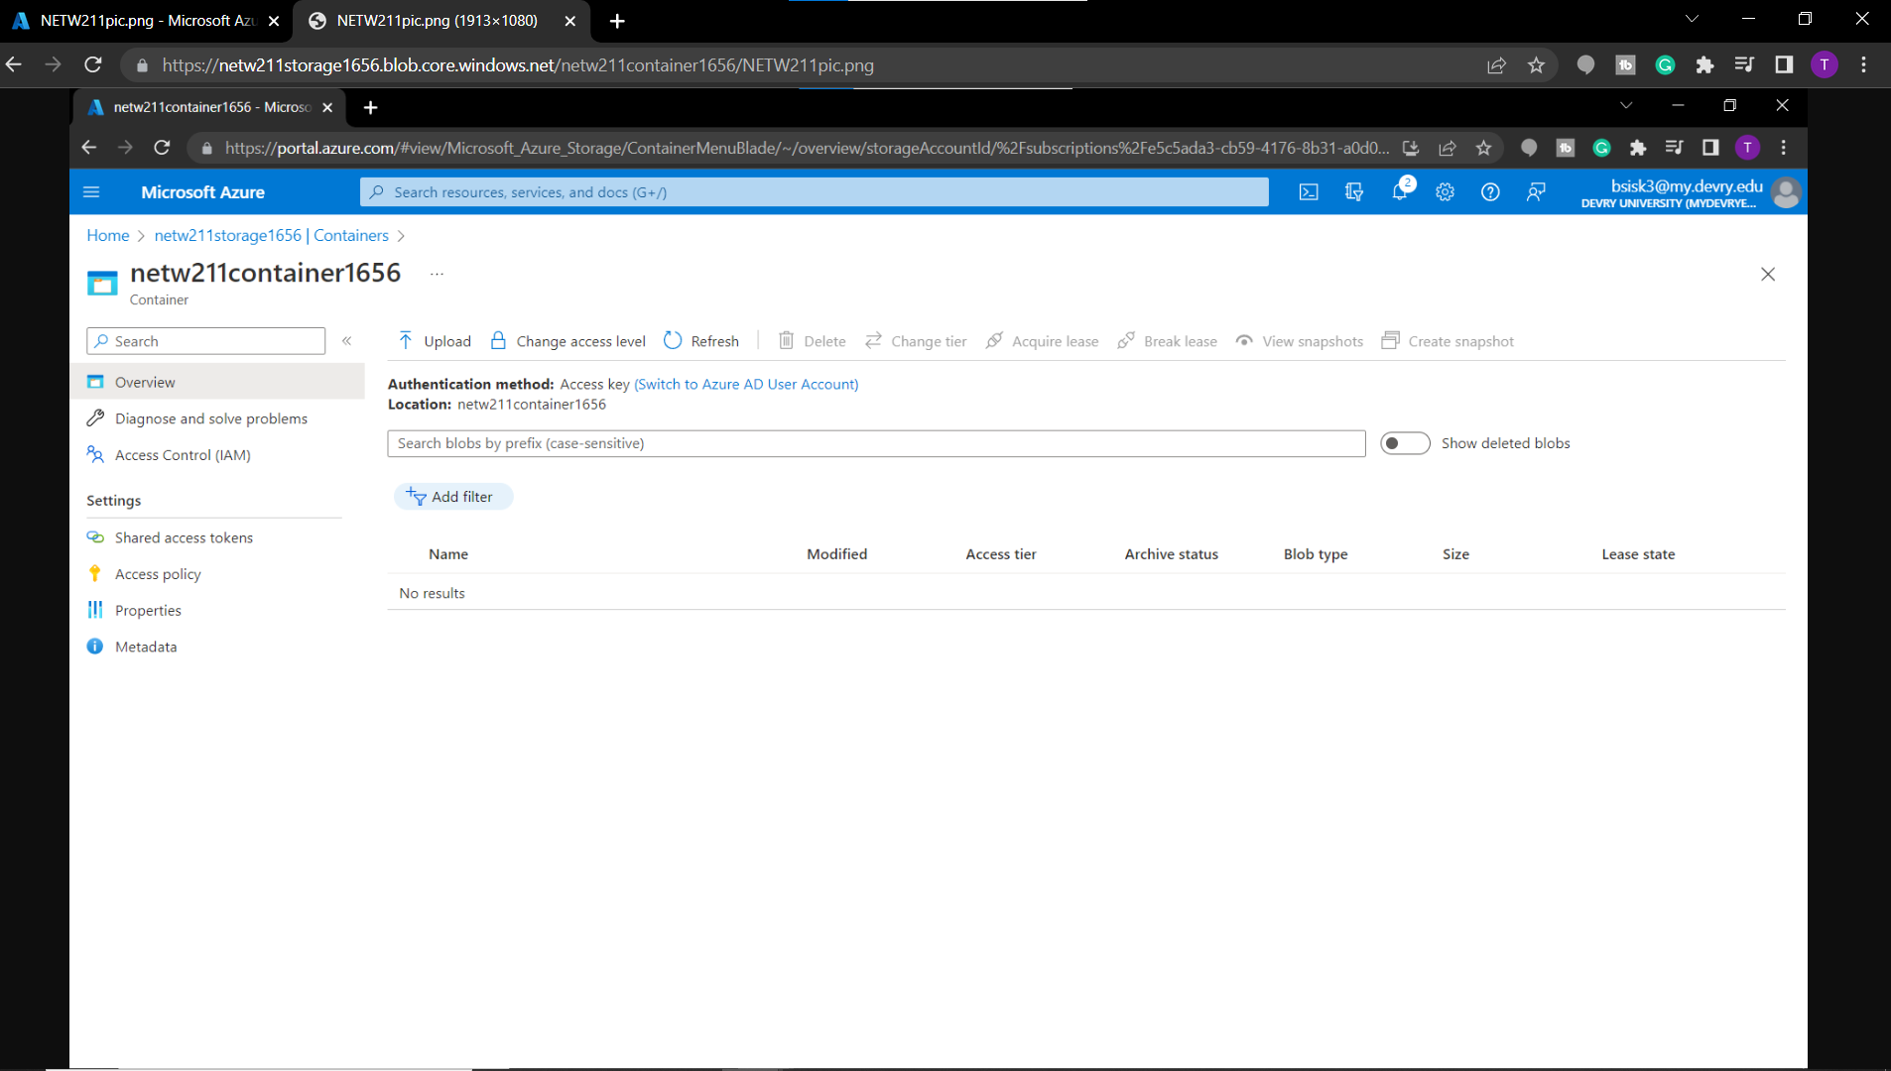
Uploading and Accessing a File

Slide 22
Question
What does the access tier setting do? What are the Azure blob storage access tiers?
[hint: in the Azure portal, on the Upload blob page, under Advanced, click the ? circle above the Access tier box.]
Answer here:
Access tier determines which online tier a new blob is created by default.
Azure blob storage access tiers is a tool that can be used to reduce cost, the tiers are divided into three groups based on how frequently it accessed and how rapidly it is required and those groups are hot, cool, and archive.
References (here are two examples to get your research started):
1. Hot, Cool, and Archive access tiers for blob data, https://docs.microsoft.com/en-us/azure/storage/blobs/access-tiers-overview
2. Azure Blob Storage Access Tiers, https://devry.percipio.com/courses/c7ef0333-8560-403f-a004-9c5c843866b0/videos/2658bbe6-ee97-438b-a376-fbb079c3b3a0
3.
4.

Slide 23
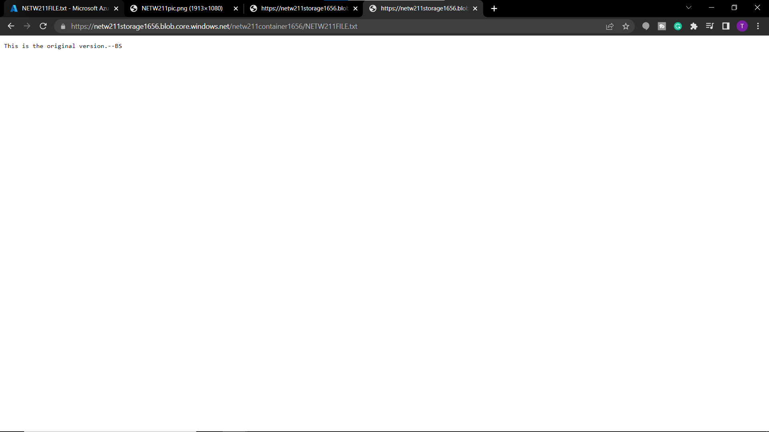
Creating Blob Snapshots

Slide 24
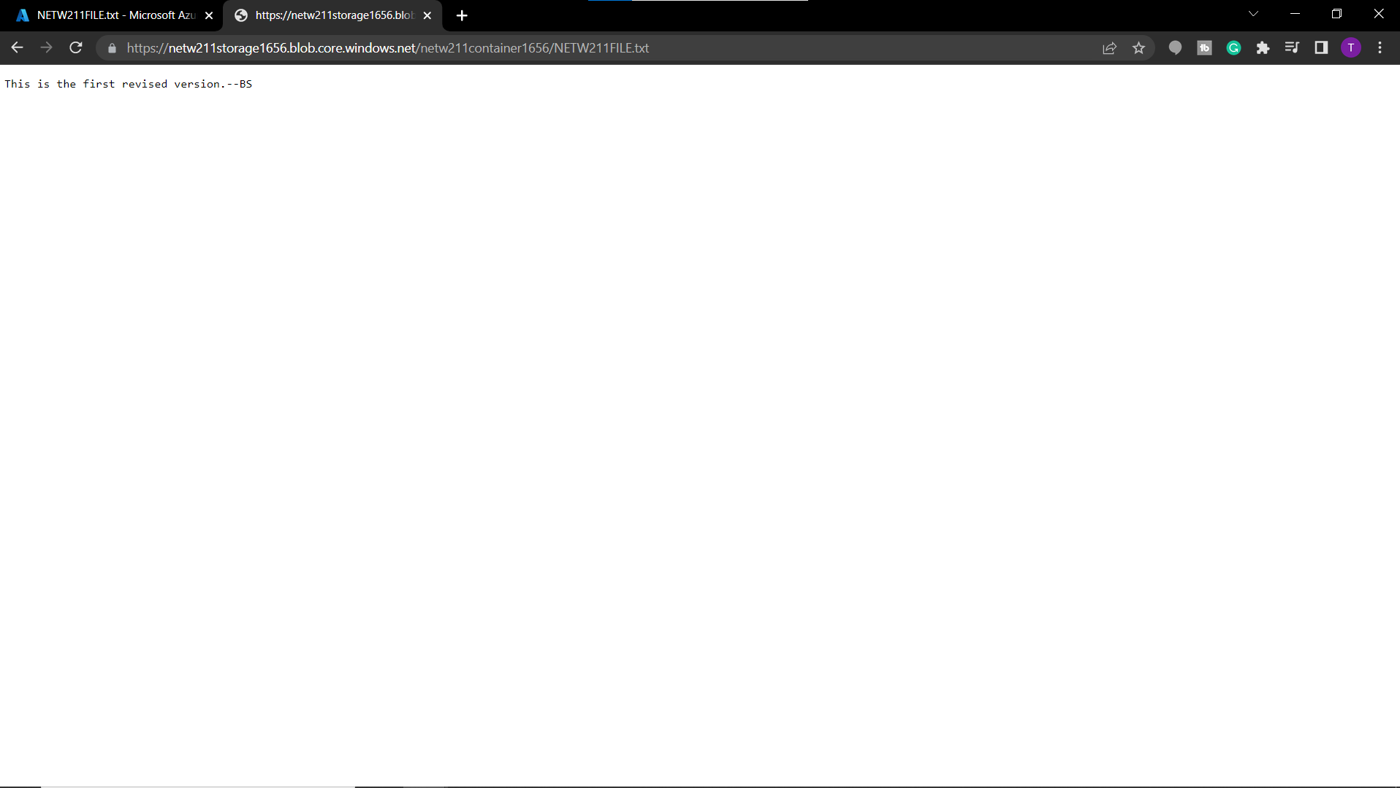
Enabling Blob Versioning

Slide 25
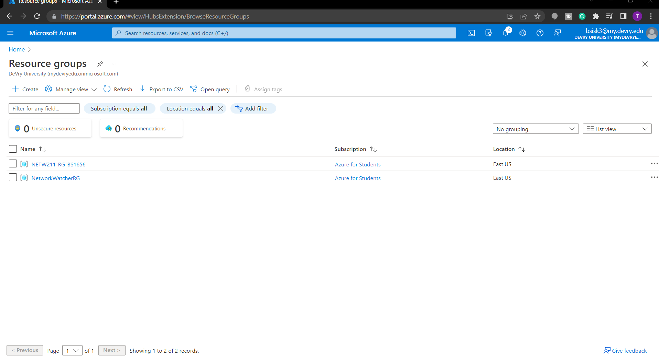
Setting up an Action Group and Notifications

Slide 26
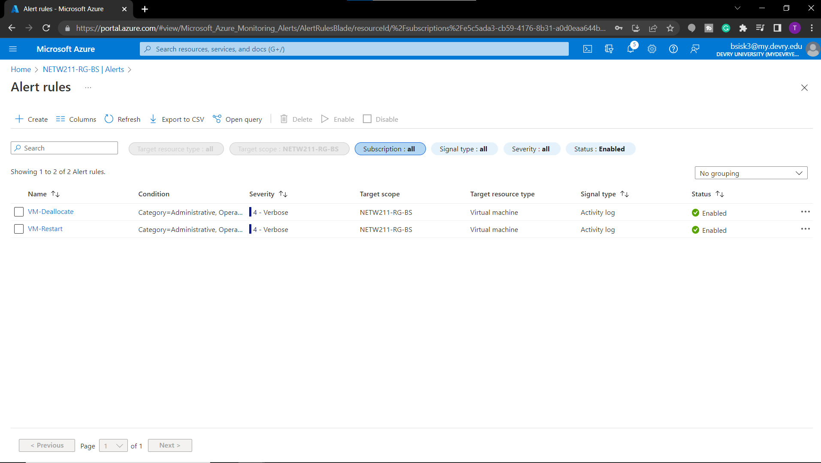
This screenshot should show the Alert rules window showing the VM-Deallocate and VM-Restart rules.
Setting up Alert Rules

Slide 27
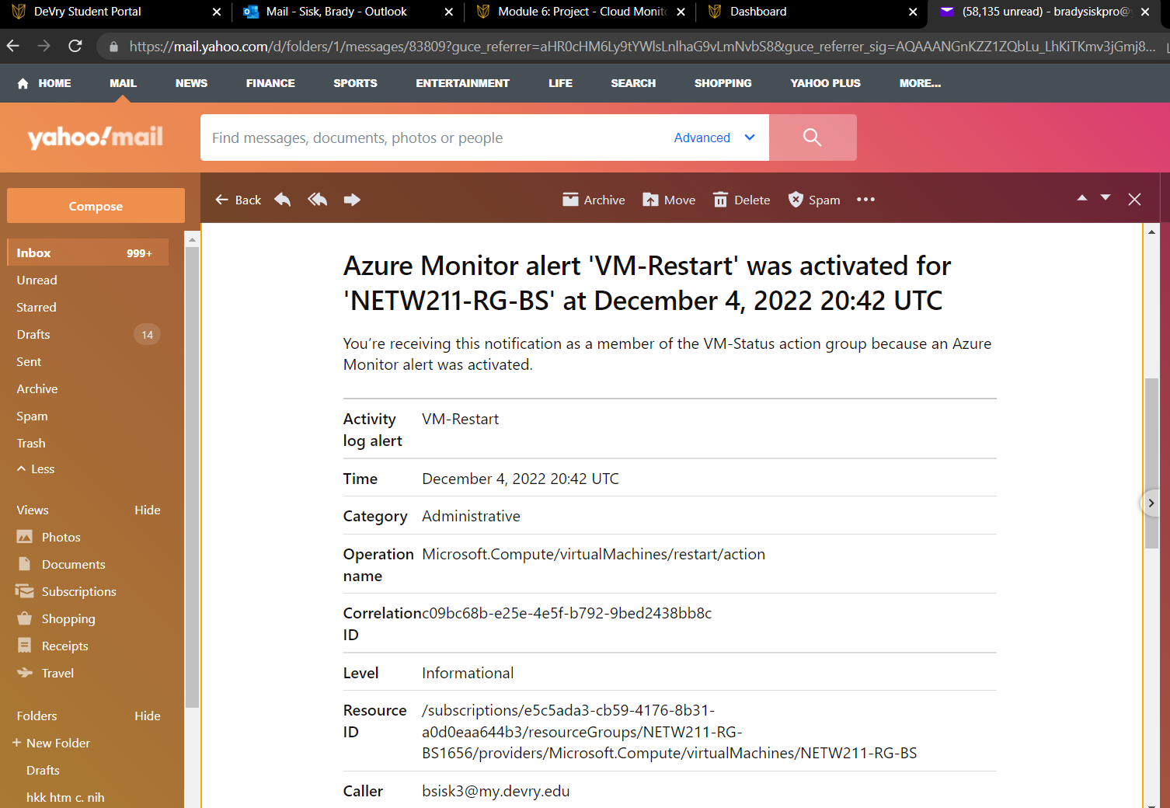
Testing Alerts

Slide 28
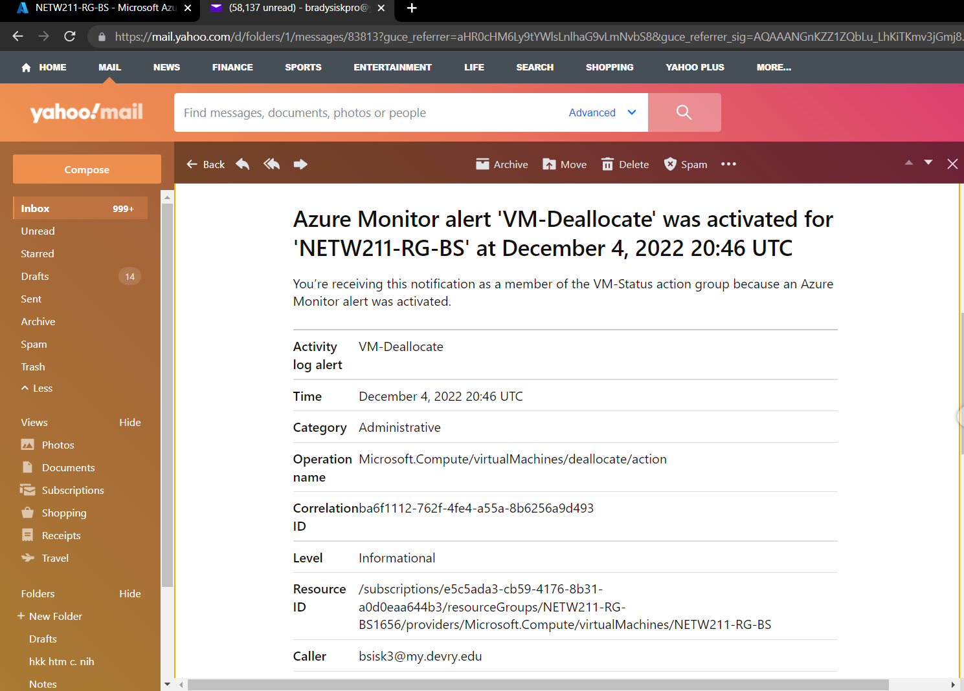
Testing Alerts cont’d

Slide 29
Challenges
I didn’t run into a lot of challenges throughout the course but if it would be anything I think it would have to be remembering all the commands and what they do when working in the command prompt

Slide 30
References
Site: https://bradysisk.github.io/

Slide 31
conclusion
This project deals with some of the basics in cloud computing
Is a stepping stone into a very broad industry

